Slide 1


Presented by ANKIT KUMAR (202200158) Under the Supervision of DR. JITENDRA SINGH TAMANG ASSISTANT PROFESSOR (SG) DEPARTMENT OF ELECTRONICS AND COMMUNICATION ENGINEERING SIKKIM MANIPAL INSTITUTE OF TECHNOLOGY
B.Tech. Major Project Phase-II
Presentation on AI-Based Smart Energy Monitoring System

Slide 2
ORGANIZATION OF PRESENTATION
Slide No. | Title
4 | INTRODUCTION
5 | MOTIVATION
6 | PROBLEM STATEMENT
7 | OBJECTIVES
8-10 | LITERATURE SURVEY
11 | RESEARCH GAP
12 | PROPOSED SOLUTION
13 | SYSTEM ARCHITECTURE
14 | BLOCK DIAGRAM
15-16 | METHODOLOGY

Slide 3
ORGANIZATION OF PRESENTATION
Slide No. | Title
17-18 | BILSTM-BASED NILM MODEL
19 | RESULTS & PERFORMANCE EVALUATION
20 | DASHBOARD RESUTS
21-23 | APPLIANCE ANALYSIS RESULTS
24 | ANOMALY DETECTION RESULTS
25 | ELECTRICITY BILL ESTIMATION RESULTS
26 | CONCLUSION
27 | FUTURE SCOPE
28 | GANTT CHART
29 | REFERENCES

Slide 4
INTRODUCTION
Residential electricity consumption has increased significantly due to the widespread use of household electrical appliances.
Conventional electricity meters provide only total household energy consumption and do not offer appliance-level energy usage information.
Non-Intrusive Load Monitoring (NILM) enables appliance-level energy estimation from aggregate household power measurements without requiring dedicated sensors.
Deep learning techniques can effectively learn consumption patterns from electricity data and improve energy disaggregation performance.
This project develops an AI-Based Smart Energy Monitoring System using a BiLSTM-based NILM model, anomaly detection, electricity bill estimation, and an interactive Streamlit dashboard.

Slide 5
MOTIVATION
Rising electricity consumption and increasing energy costs have highlighted the need for efficient household energy management.
Consumers often lack awareness of how individual appliances contribute to overall electricity usage.
Identifying high-energy-consuming appliances can help reduce unnecessary energy consumption and electricity expenses.
Advances in artificial intelligence and deep learning enable intelligent analysis of household electricity consumption data.
An appliance-level energy monitoring system can improve energy awareness and support informed decision-making for efficient electricity usage

Slide 6
PROBLEM STATEMENT
Conventional electricity meters provide only aggregate household energy consumption and do not offer appliance-level visibility.
Users cannot easily identify high-energy-consuming appliances or inefficient energy usage patterns.
Abnormal appliance behavior and unusual energy consumption often remain undetected.
Installing dedicated sensors for individual appliances increases hardware cost, installation complexity, and maintenance requirements.
There is a need for an intelligent and cost-effective system capable of estimating appliance-level energy consumption from aggregate household power measurements.

Slide 7
OBJECTIVES
To develop a BiLSTM-based NILM model for estimating appliance-level energy consumption from aggregate household electricity data.
To analyze appliance-wise energy consumption patterns using the UK-DALE dataset.
To detect unusual energy consumption behavior through anomaly detection techniques.
To estimate electricity expenditure based on predicted appliance-level energy usage.
To develop an interactive Streamlit dashboard for visualization, monitoring, and analysis of household energy consumption.

Slide 8
LITERATURE SURVEY
Sl. No | Author | Title of the paper | Journal/Conference /Book name | Findings | Gap analysis | Relevance to the project
1. | Huzzat et al. (2025) | A Survey of Traditional and Emerging Deep Learning Techniques for NILM | AI Journal (MDPI) | Presents a detailed overview of NILM research and discusses the evolution of deep learning techniques such as CNNs, LSTMs, and Transformers for appliance-level energy estimation. | The work mainly reviews existing approaches and does not implement a complete monitoring framework for practical deployment. | Provided background knowledge on modern NILM methodologies and guided the selection of deep learning techniques for the proposed system.
2. | Huber et al. (2021) | Review on Deep Neural Networks Applied to Low-Frequency NILM | Energies (MDPI) | Examines the application of deep neural network models for low-frequency NILM data and evaluates their effectiveness in energy disaggregation tasks. | The study concentrates on model evaluation and lacks features related to visualization, analytics, and end-user interaction. | Helped establish the suitability of deep learning models for appliance-level energy prediction from aggregate power measurements.

Slide 9
LITERATURE SURVEY
Sl. No | Author | Title of the paper | Journal/Conference /Book name | Findings | Gap analysis | Relevance to the project
3. | Kelly and Knottenbelt (2015) | Neural NILM: Deep Neural Networks Applied to Energy Disaggregation | ACM e-Energy Conference | Introduced deep learning-based NILM approaches and demonstrated the potential of neural networks for improving energy disaggregation performance. | The research primarily emphasizes model development and provides limited support for user-oriented monitoring applications. | Served as one of the foundational studies influencing the adoption of deep learning methods in NILM systems.
4. | Zhou et al. (2021) | Non-Intrusive Load Monitoring Using a CNN-LSTM-RF Model Considering Label Correlation and Class-Imbalance | IEEE Access | Proposed a hybrid framework combining CNN, LSTM, and Random Forest models to enhance appliance classification and energy estimation accuracy. | The hybrid architecture increases computational complexity and offers limited integration with practical energy management tools. | Demonstrated the effectiveness of sequence-based learning methods for improving appliance recognition and disaggregation accuracy.

Slide 10
LITERATURE SURVEY
Sl. No | Author | Title of the paper | Journal/Conference /Book name | Findings | Gap analysis | Relevance to the project
5. | Zai et al. (2023) | Non-Intrusive Load Monitoring Based on the Combination of Gate-Transformer and CNN | Electronics (MDPI) | Utilized Transformer and CNN architectures to capture complex consumption patterns and improve NILM prediction performance. | The approach requires significant computational resources and focuses mainly on prediction accuracy rather than complete energy monitoring solutions. | Provided insights into recent advancements in NILM architectures and highlighted the importance of intelligent energy monitoring systems.
6. | Zhang et al. (2018) | Sequence-to-Point Learning with Neural Networks for NILM | AAAI Workshop / NILM Research | Introduced a sequence-to-point learning framework capable of estimating appliance-level consumption directly from aggregate electricity signals. | The study mainly targets energy disaggregation and does not address analytics, anomaly detection, or visualization requirements. | Supported the adoption of temporal learning techniques for appliance-level energy estimation in the proposed system.
Table 1. Literature Survey Table

Slide 11

RESEARCH GAP
Most existing NILM studies primarily focus on improving appliance-level energy disaggregation accuracy.
Features such as anomaly detection, electricity cost estimation, and appliance-wise energy analytics are often not integrated within a single framework.
Many research works present prediction results through offline evaluation metrics, making interpretation difficult for end users.
Limited emphasis has been placed on developing user-oriented platforms that combine prediction, analysis, visualization, and decision-support capabilities.
Therefore, there is a need for an intelligent and integrated energy monitoring framework that combines appliance-level energy estimation, anomaly detection, bill estimation, and interactive visualization.

Slide 12
PROPOSED SOLUTION
To develop a BiLSTM-based NILM model for estimating appliance-level energy consumption from aggregate household electricity data.
A Bidirectional Long Short-Term Memory (BiLSTM) model is utilized to learn temporal consumption patterns and predict the energy usage of selected household appliances.
The UK-DALE dataset is used for model training and evaluation, providing both aggregate and appliance-level electricity consumption data.
The system incorporates anomaly detection and electricity bill estimation to provide additional energy insights beyond energy disaggregation.
A Streamlit-based dashboard is developed to visualize appliance-level consumption, energy trends, anomaly alerts, and estimated electricity costs.

Slide 13
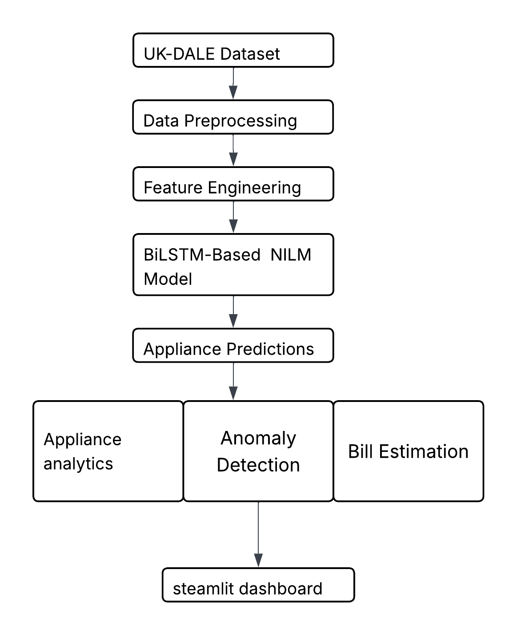
SYSTEM ARCHITECTURE
UK-DALE dataset: provides aggregate and appliance-level household electricity consumption data.
• Data preprocessing & feature engineering: performs data cleaning, normalization, and extraction of temporal and statistical features.
• BiLSTM-based NILM model: learns consumption patterns from aggregate power data and estimates appliance-level energy usage.
• Analytics modules: perform appliance consumption analysis, anomaly detection, and electricity bill estimation.
• Streamlit dashboard: presents energy consumption trends, anomaly alerts, appliance analytics, and estimated electricity costs through an interactive interface.
Figure 1. System Architecture of the Proposed AI-Based Smart Energy Monitoring System

Slide 14
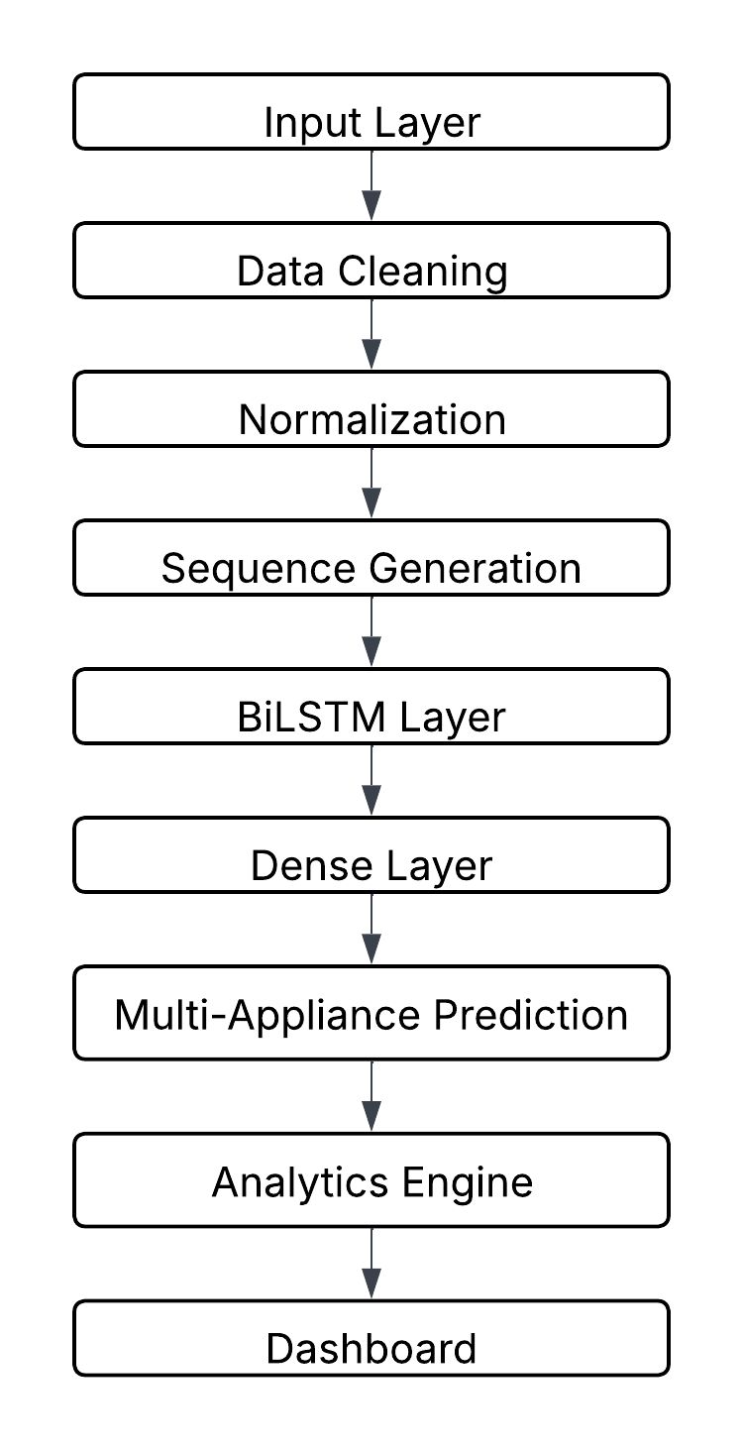
BLOCK DIAGRAM
Figure 2. Detailed Operational Block Diagram of the Proposed AI-Based Smart Energy Monitoring System

Slide 15
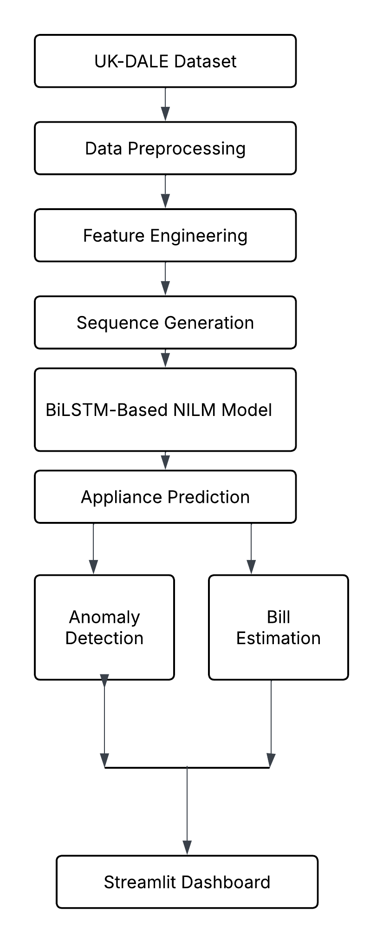
METHODOLOGY
Methodology Steps
Dataset Collection
UK-DALE household electricity consumption dataset.
2. Data Preprocessing
Data cleaning
Missing value handling
Hourly resampling
Normalization
3. Feature Engineering
Temporal features
Lag features
Rolling statistics
Cyclical time features
Figure 3. Overall Solution Strategy of the Proposed AI-Based Smart Energy Monitoring System

Slide 16
METHODOLOGY
Methodology Steps
4. Sequence Generation
24-hour sliding window sequences
5. BiLSTM Based NILM Model
Appliance-level energy disaggregation
6. Prediction & Analytics
Appliance predictions
Anomaly detection
Bill estimation
7. Dashboard Visualization
Streamlit-based interactive dashboard
Figure 3. Overall Solution Strategy of the Proposed AI-Based Smart Energy Monitoring System

Slide 17
BiLSTM-BASED NILM MODEL
Model Architecture
• Input Layer: 24-hour sequential windows generated from the processed dataset.
• BiLSTM Layer 1: 128 hidden units for learning temporal consumption patterns.
• Batch Normalization & Dropout (0.2): Improve training stability and reduce overfitting.
• BiLSTM Layer 2: 64 hidden units for extracting higher-level temporal features.
• Dense Layer: 64 neurons with L2 regularization for feature refinement.

Slide 18
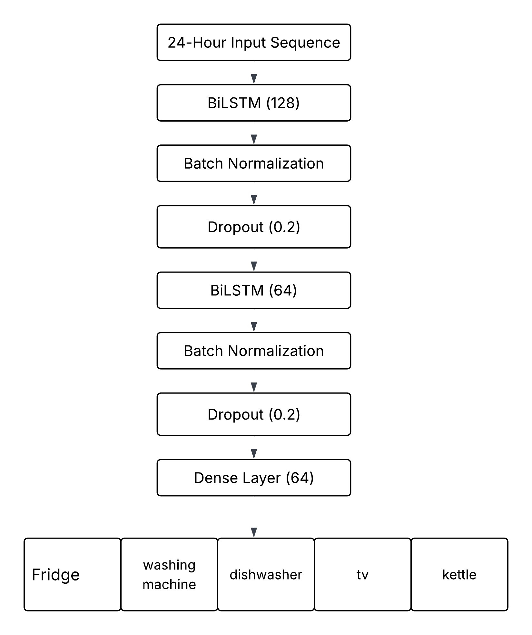
BiLSTM-BASED NILM MODEL
Multi-Output Prediction: Simultaneous prediction of:
Refrigerator
Washing Machine
Dishwasher
Television
Kettle
Training Configuration
• Optimizer: Adam (Learning Rate = 0.001)
• Loss Function: Huber Loss
• Batch Size: 64
• Maximum Epochs: 200
• Validation Split: 15%
Figure 4. BiLSTM-Based NILM Model Architecture

Slide 19
RESULTS & PERFORMANCE EVALUATION
The Kettle achieved the highest performance with an F1 Score of 0.996.
The Television demonstrated strong prediction capability with an F1 Score of 0.824.
The Dishwasher achieved the lowest MAE (0.1073 kWh) among all appliances.
The Refrigerator and Washing Machine exhibited lower F1 Scores due to complex and overlapping consumption patterns.
The results demonstrate the effectiveness of the proposed BiLSTM-based NILM model for appliance-level energy disaggregation.
Appliance | MAE (kWh) | F1 Score
Refrigerator | 0.4813 | 0.138
Washing Machine | 0.4849 | 0.147
Dishwasher | 0.1073 | 0.482
Television | 0.1598 | 0.824
Kettle | 0.1463 | 0.996
Table 2. Appliance-Wise Performance Evaluation Results

Slide 20
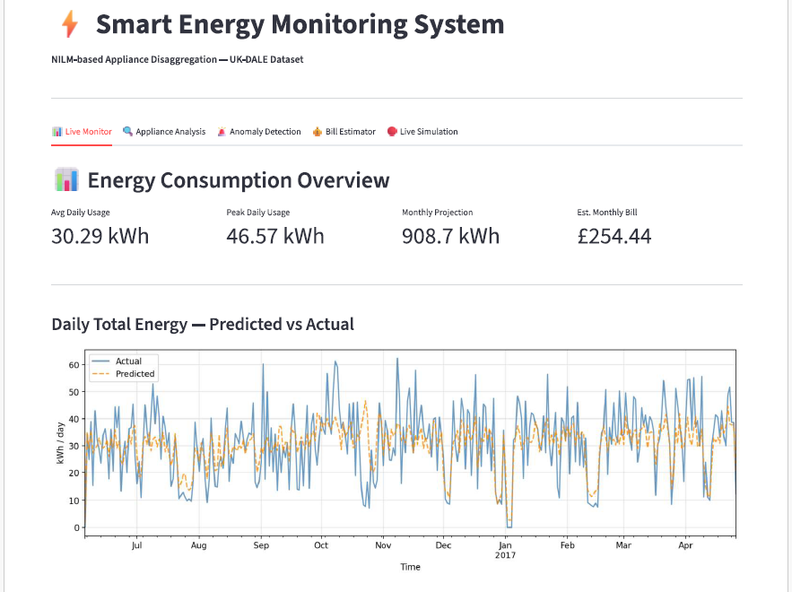
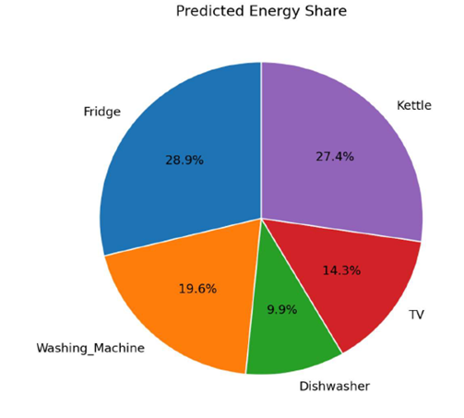
DASHBOARD RESULTS
Figure 6. Predicted Energy Share
Figure 5.User Interface of the Streamlit-Based Energy Monitoring Dashboard

Slide 21
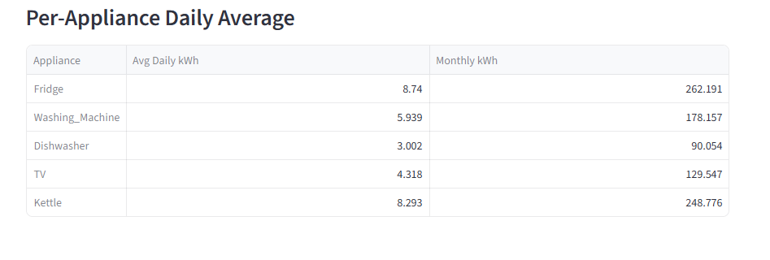
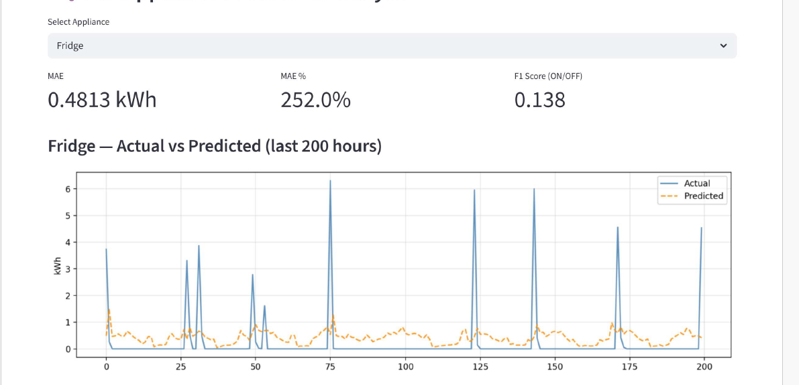
APPLIANCE ANALYSIS RESULTS
Figure 7. Per- Appliance Daily Average
Figure 8(a). Fridge – actual vs predicted

Slide 22
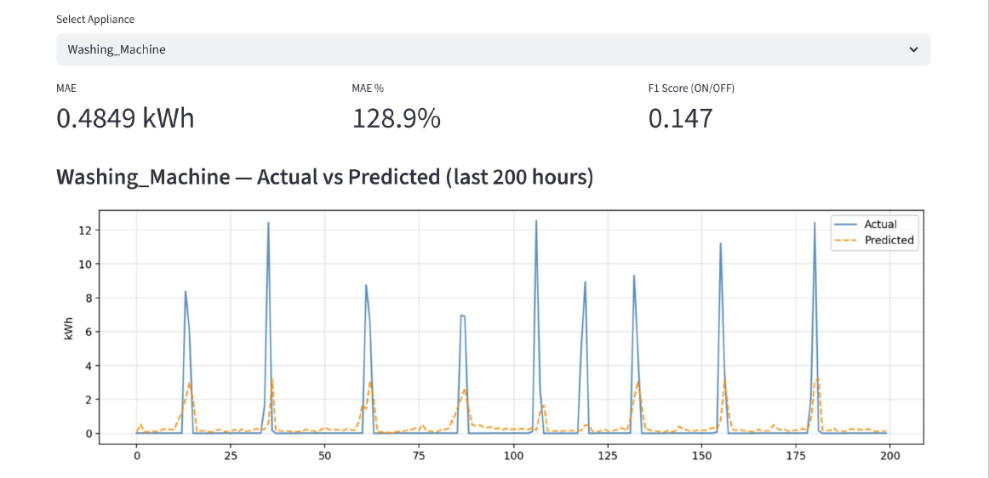
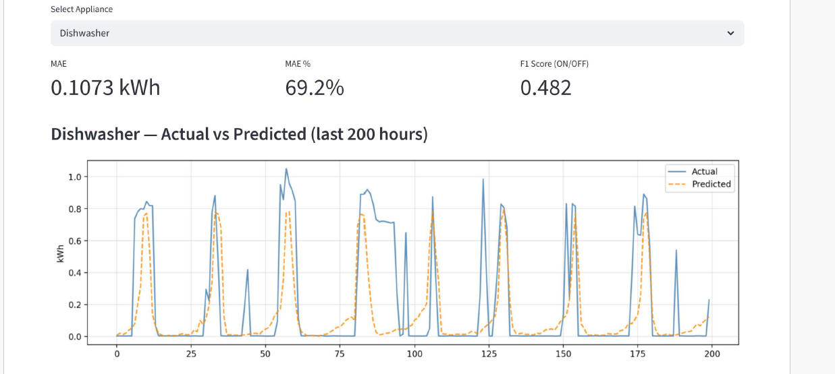
APPLIANCE ANALYSIS RESULTS
Figure 8(b): Washing Machine – actual vs predicted
Figure 8(c) : Dishwasher – actual vs predicted

Slide 23
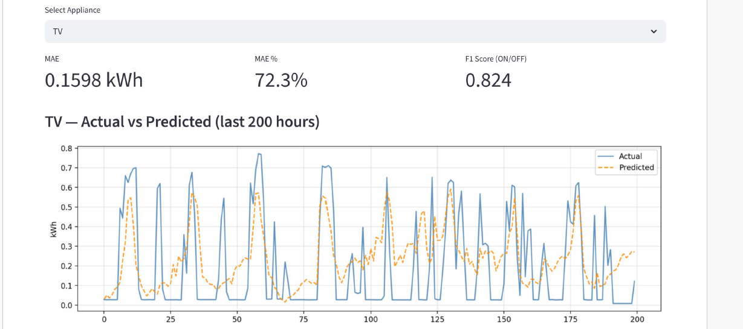
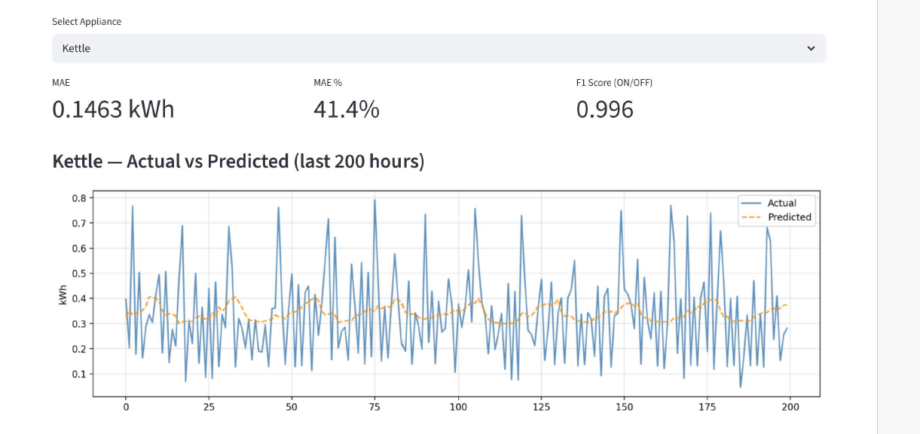
APPLIANCE ANALYSIS RESULTS
Figure 8(d) : TV – actual vs predicted
Figure 8(e) : Kettle – actual vs predicted

Slide 24
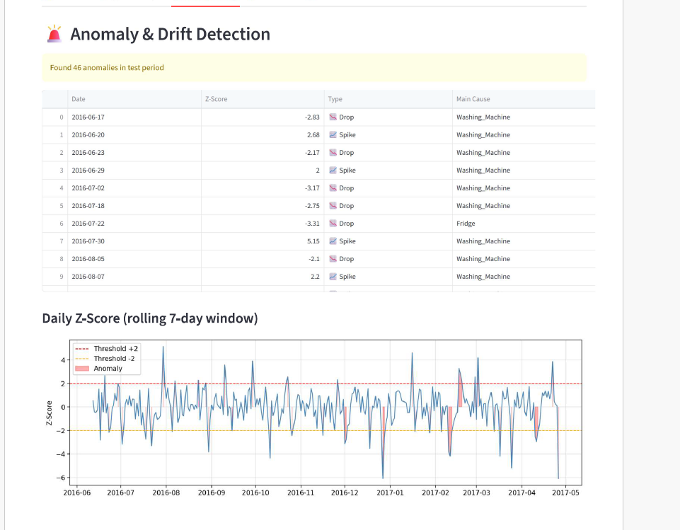
ANOMALY DETECTION RESULTS
Detects unusual appliance energy consumption patterns.
A rolling 7-day Z-score analysis is used to detect significant deviations from normal energy usage behavior.
During the evaluation period, a total of 46 anomalous events were identified.
Detected anomalies were classified as:
Consumption Spikes (abnormally high energy usage)
Consumption Drops (abnormally low energy usage)
The detected anomalies were primarily associated with appliances such as the Refrigerator and Washing Machine, which exhibit varying operational patterns.
Provides early warnings for abnormal appliance operation and energy inefficiencies.
Figure 9. Anomaly and Drift Detection

Slide 25
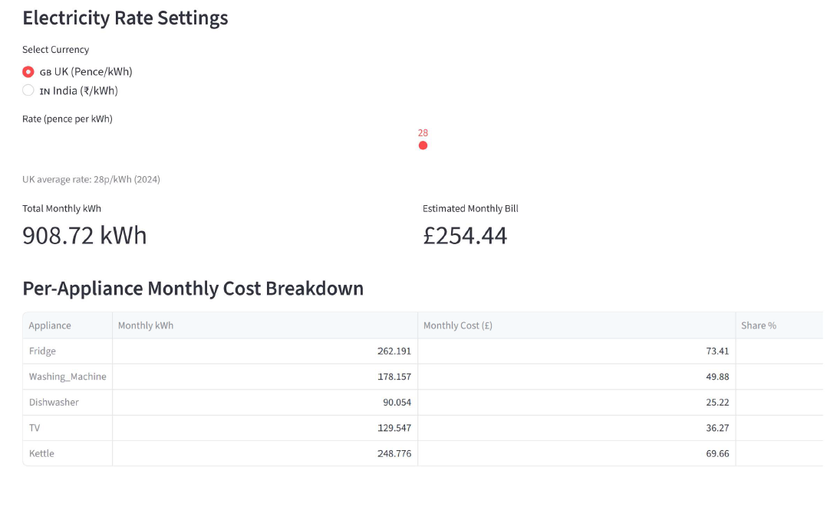
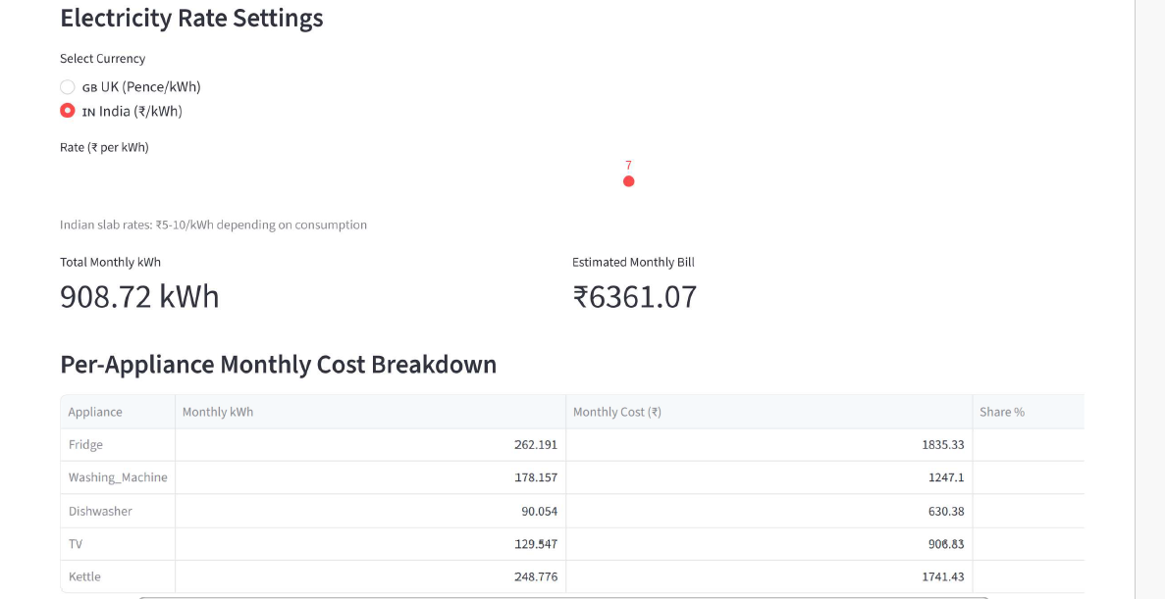

ELECTRICITY BILL ESTIMATION RESULTS
Figure 10. Electricity Bill Estimation in GB UK
Projected monthly energy consumption: 908.72 kWh
UK tariff (28 pence/kWh): £254.44
Indian tariff (₹7/kWh): ₹6361.07
Appliance-wise monthly cost breakdown is provided through the dashboard.
Refrigerator and Kettle contribute the highest monthly electricity cost.
Supports energy awareness and cost optimization.
Figure 11. Electricity Bill Estimation in Indian Rupee

Slide 26
CONCLUSION
A BiLSTM-based NILM model was developed to estimate appliance-level energy consumption from aggregate household electricity measurements.
The model successfully learned appliance consumption patterns and achieved strong performance for appliances with distinct energy signatures, particularly the Kettle and Television.
The system integrated anomaly detection, electricity bill estimation, and appliance-level energy analytics to enhance practical usability.
An interactive Streamlit dashboard was developed to visualize energy consumption trends, appliance predictions, anomaly alerts, and electricity costs.
The proposed AI-Based Smart Energy Monitoring System successfully achieved its objectives and demonstrated the effectiveness of deep learning-based NILM for residential energy monitoring and management.

Slide 27
FUTURE SCOPE
Integration with real-time smart meters and IoT devices for live household energy monitoring.
Deployment of the NILM model on edge-computing platforms such as Raspberry Pi for real-time inference.
Exploration of advanced architectures such as Transformer-based and attention-based models to improve prediction accuracy.
Extension of the system to support a larger number of household appliances and diverse residential environments.
Development of personalized energy-saving recommendations and predictive maintenance features for smart home applications.

Slide 28
GANTT CHART
ACTIVITY | TIME FRAME (in Months)
MONTHS | JANUARY 2026 |  | FEBRUARY 2026 |  |  | MARCH 2026 |  | APRIL 2026 |  | May 2026
LITERATURE SURVEY
PROBLEM DEFINITION
IMPLEMENTATION
TESTING AND VALIDATION
REPORT WRITING
 |  | ACTIVITY PROPOSED |  |  |  |  |  | ACTIVITY ACHIEVED
Figure 12. TIMELINE AND MILESTONES FOR AI-BASED SMART ENERGY MONITORING SYSTEM

Slide 29
REFERENCES
[1] Annysha, Huzzat, Ahmed S. Khwaja, Ali A. Alnoman, Adhikari Bhagawat, Anpalagan Alagan, and Woungang Isaac. "A Survey of Traditional and Emerging Deep Learning Techniques for Non-Intrusive Load Monitoring." AI 6, no. 9 (2025): 213.
[2] Huber, Patrick, Alberto Calatroni, Andreas Rumsch, and Andrew Paice. "Review on deep neural networks applied to low-frequency nilm." Energies 14, no. 9 (2021): 2390.
[3] Kelly, Jack, and William Knottenbelt. "Neural nilm: Deep neural networks applied to energy disaggregatio." In Proceedings of the 2nd ACM international conference on embedded systems for energy-efficient built environments, pp. 55-64. 2015.
[4] Zhou, Xiao, Shujian Li, Chengxi Liu, Haojun Zhu, Nan Dong, and Tianying Xiao. "Non-intrusive load monitoring using a CNN-LSTM-RF model considering label correlation and class-imbalance." IEEE Access 9 (2021): 84306-84315.
[5] Zai, Zhoupeng, Sheng Zhao, Zhengjiang Zhang, Haolei Li, and Nianqi Sun. "Non-intrusive load monitoring based on the combination of gate-transformer and CNN." Electronics 12, no. 13 (2023): 2824.
[6] Zhang, Chaoyun, Mingjun Zhong, Zongzuo Wang, Nigel Goddard, and Charles Sutton. "Sequence-to-point learning with neural networks for non-intrusive load monitoring." In Proceedings of the AAAI conference on artificial intelligence, vol. 32, no. 1. 2018.

Slide 30
THANK YOU

